Slide 1
MAX Plus Algebra
Waylon Jepsen

Slide 2
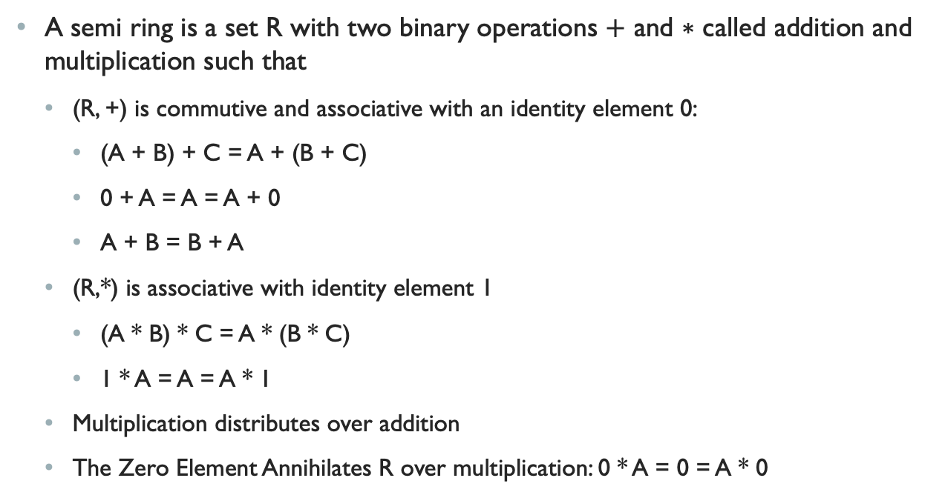
Max Plus Algebra is a Semi-ring
A semi ring is a set R with two binary operations $+$ and $∗$ called addition and multiplication such that
(R, +) is commutive and associative with an identity element 0:
(A + B) + C = A + (B + C)
0 + A = A = A + 0
A + B = B + A
(R,*) is associative with identity element 1
(A * B) * C = A * (B * C)
1 * A = A = A * 1
Multiplication distributes over addition
The Zero Element Annihilates R over multiplication: 0 * A = 0 = A * 0

Slide 3
Ring vs Semi-Ring
A Semi ring omits the requirement of an additive inverse
In a ring an additive inverse implies a multiplicative zero which is why it needs to be explicitly specified here.
(Max, +) and (Min, +) are classified as tropical semi-rings (where Min/Max and addition is used to replace the traditional multiplication and addition.
These tropical semi-rings have applications in evaluating the performance of discrete event systems.
Real numbers are arrival times
Max can be used to refer to waiting for a completion of all prior events
Min can be used to select the best least costly choice
+ is an accumulation along a path

Slide 4
Examples in Computer Science
The Floyd-Warshall Algorithm is an algorithm for finding shortest paths in a directed weighted graph.
Described by the (min, +) tropical semi-ring.
+ accumulates the weight along a path
min chooses the shortest one.
The Viterbi algorithm for dynamic programing applies a similar representation

Slide 5
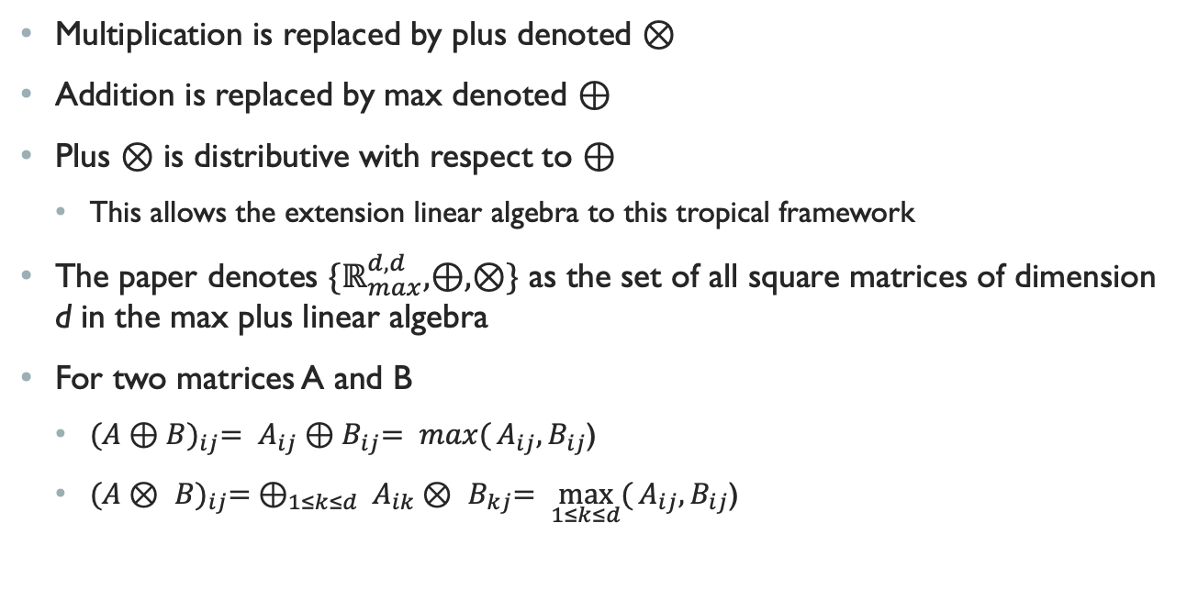
Max plus
Multiplication is replaced by plus denoted $⊗$
Addition is replaced by max denoted $⊕$
Plus $⊗$ is distributive with respect to $⊕$
This allows the extension linear algebra to this tropical framework
The paper denotes ${\{ℝ}_{max}^{d,d},⊕,⊗\}$ as the set of all square matrices of dimension d in the max plus linear algebra
For two matrices A and B
${(A⊕B)}_{ij}= A_{ij}{⊕B}_{ij}= \max{(}A_{ij}{,B}_{ij}$)
${(A⊗ B)}_{ij}= ⊕_{1≤k≤d} A_{ik}{⊗ B}_{kj}= \max_{1≤k≤d}{(}A_{ij}{,B}_{ij}$)

Slide 6
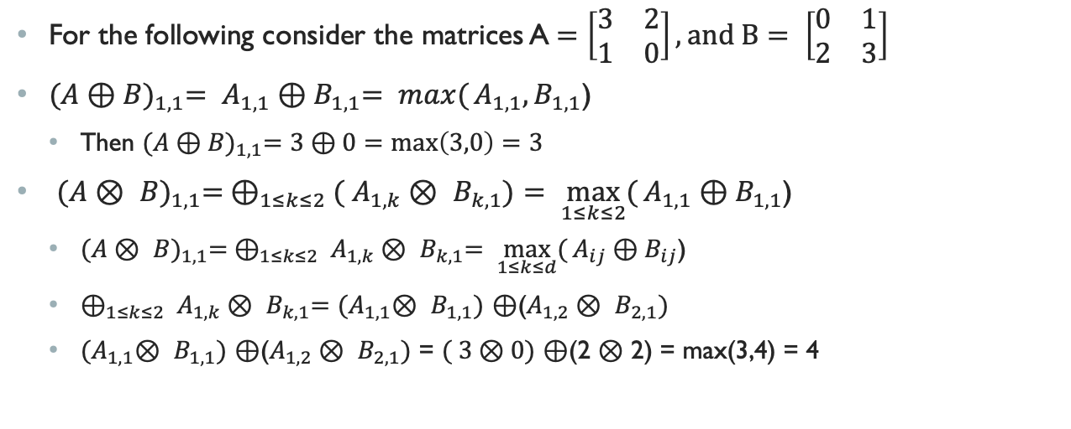
Examples
For the following consider the matrices A$=\left[\begin{matrix}3 & 2 \\ 1 & 0\end{matrix}\right], and B= \left[\begin{matrix}0 & 1 \\ 2 & 3\end{matrix}\right]$
${(A⊕B)}_{1,1}= A_{1,1}{⊕B}_{1,1}= \max{(}A_{1,1}{,B}_{1,1}$)
Then ${(A⊕B)}_{1,1}=3⊕0=max\left(3,0\right)=3$
${(A⊗ B)}_{1,1}= ⊕_{1≤k≤2}( A_{1,k}{⊗ B}_{k,1})= \max_{1≤k≤2}{(}A_{1,1}{⊕B}_{1,1}$)
${(A⊗ B)}_{1,1}= ⊕_{1≤k≤2} A_{1,k}{⊗ B}_{k,1}= \max_{1≤k≤d}{(}A_{ij}{⊕B}_{ij}$)
$⊕_{1≤k≤2} A_{1,k}{⊗ B}_{k,1}=$ ${(A}_{1,1}{⊗ B}_{1,1})$ $⊕$($A_{1,2}{⊗ B}_{2,1})$
${(A}_{1,1}{⊗ B}_{1,1})$ $⊕$($A_{1,2}{⊗ B}_{2,1})$ = $( 3⊗0)$ $⊕$(2 $⊗$ 2) = max(3,4) = 4

Slide 7
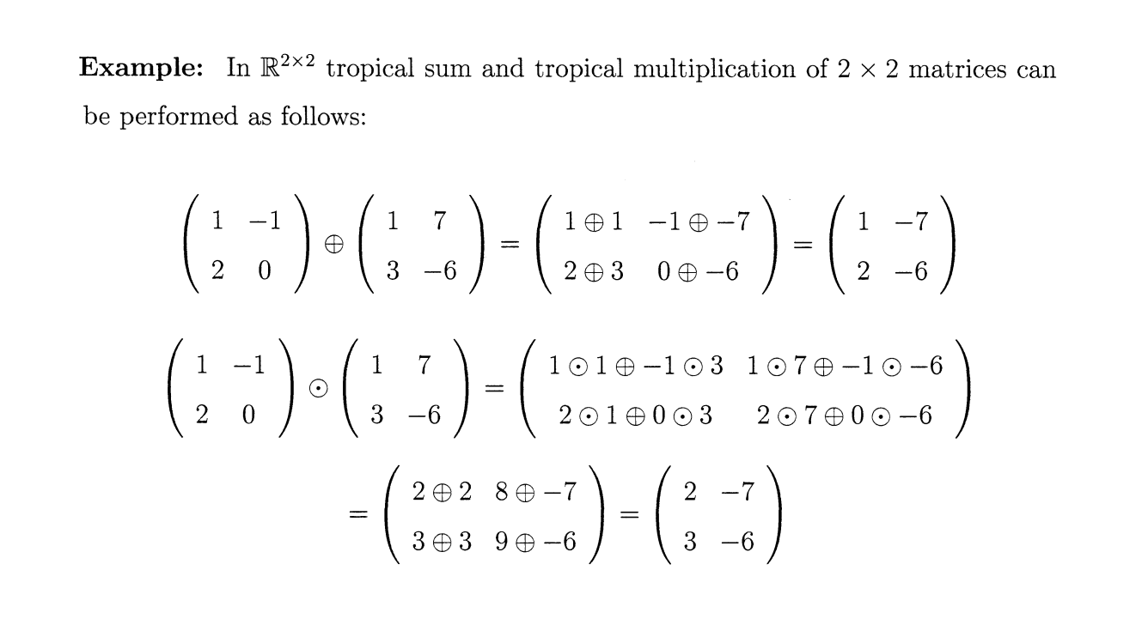
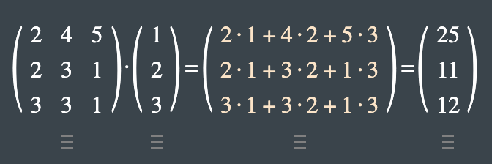
Examples
In Regular Algebra

Slide 8
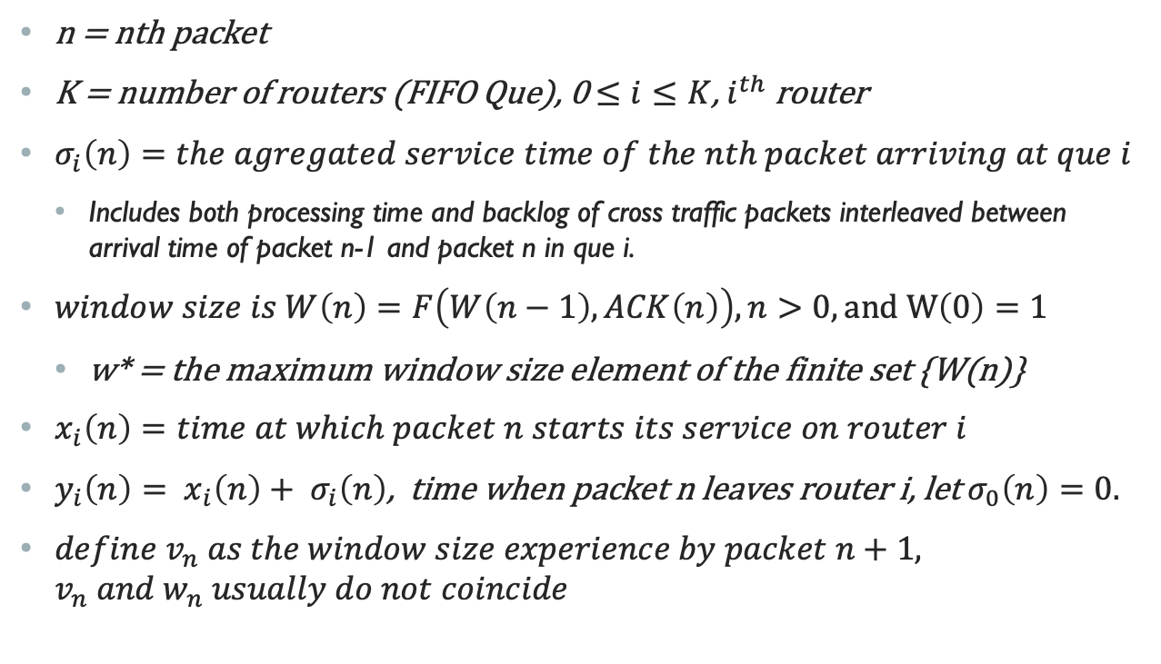
Definitions
n = nth packet
K = number of routers (FIFO Que), 0 $≤i≤K$, $i^{th}$ router
$σ_{i}\left(n\right)=the agregated service time of the nth packet arriving at que i$
Includes both processing time and backlog of cross traffic packets interleaved between arrival time of packet n-1 and packet n in que i.
$window size is W\left(n\right)=F\left(W\left(n−1\right),ACK\left(n\right)\right), n>0, and W\left(0\right)=1$
w* = the maximum window size element of the finite set {W(n)}
$x_{i}\left(n\right)=time at which packet n starts its service on router i$
$y_{i}\left(n\right)= x_{i}\left(n\right)+ σ_{i}\left(n\right)$, time when packet n leaves router i, let $σ_{0}\left(n\right)=0.$
${define v}_{n} as the window size experience by packet n+1, v_{n} and w_{n} usually do not coincide$

Slide 9
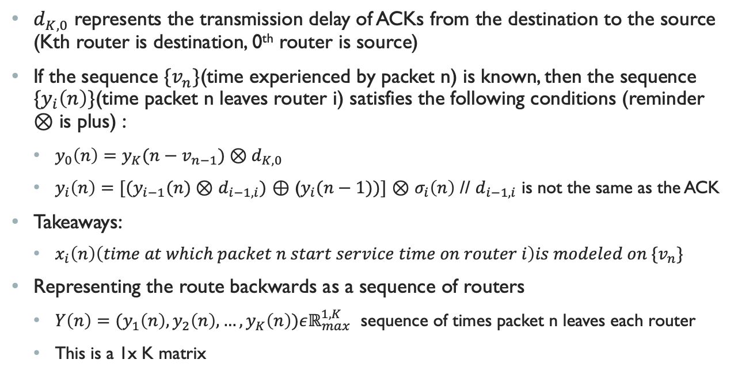
Continued
$d_{K,0}$ represents the transmission delay of ACKs from the destination to the source (Kth router is destination, 0th router is source)
If the sequence ${\{v}_{n}\}$(time experienced by packet n) is known, then the sequence ${\{y}_{i}\left(n\right)\}$(time packet n leaves router i) satisfies the following conditions (reminder $⊗$ is plus) :
$y_{0}\left(n\right)=y_{K}(n−v_{n−1})⊗d_{K,0}$
$y_{i}\left(n\right)=[(y_{i−1}(n)⊗$ $d_{i−1,i})$ $⊕$ ($y_{i}(n−1))]$ $⊗$ $σ_{i}\left(n\right)$ // $d_{i−1,i}$ is not the same as the ACK
Takeaways:
$x_{i}\left(n\right)\left(time at which packet n start service time on router i\right)is modeled on {\{v}_{n}\}$
Representing the route backwards as a sequence of routers
$Y\left(n\right)=(y_{1}\left(n\right),y_{2}\left(n\right),…,y_{K}\left(n\right))εℝ_{max}^{1,K}$ sequence of times packet n leaves each router
This is a 1x K matrix

Slide 10
Making Max Plus Matrices
Reminder: The route of the ACK is
$Y\left(n\right)=(y_{1}\left(n\right),y_{2}\left(n\right),…,y_{K}\left(n\right))εℝ_{max}^{1,K}$ << vector of times packet n leaves routers
Z$\left(n\right)={(Y\left(n\right),Y \left(n−1\right),…,Y\left(n−w^{∗}+1\right))}^{t}εℝ_{max}^{K.w^{∗},1}$ < this is referred to as the dater vectors << vector of vectors representing all packet paths and times
$w^{∗}$ the maximum window size element of the finite set {W(n)}
Lemma 1[Max plus representation] if the system is initially empty and the sequence ${{\{v}_{n}\}}_{nεℕ}$, then the dater vectors Z$\left(n\right)$ satisfy
Z$\left(n\right)$ = $A_{v_{n−1}}(n)$ $⊗$ Z$\left(n−1\right), n≥1, where \text{Z}\left(0\right)={\{0,…,0\}}^{t}$,
$A_{1}\left(n\right)=(M(n)$ $⊕$ $M^{′}\left(n\right)\left|ε\right|…|ε)$ $⊕$ D
$A_{2}\left(n\right)=(M(n)$ |$M^{′}\left(n\right)\left|ε\right|…|ε)$ $⊕$ D
$A_{w^{∗}}\left(n\right)=(M(n)$ $\left|ε\right|…|ε|M^{′}\left(n\right))$ $⊕$ D

Slide 11
M and M’
${(M\left(n\right))}_{i,j} = \left\{\begin{aligned}\sum_{k=j}^{i}{σ_{k}(n)}+\sum_{k=j}^{i−1}{d_{k,k−1}}, if i ≥j \\ −∞, if i<j\end{aligned}\right.$
${(M′\left(n\right))}_{i,j} = \left\{\begin{aligned}\sum_{k=1}^{i}{(d_{k−1,k}}+σ_{k}(n))+d_{K,0}, if j=K \\ −∞, if j<K\end{aligned}\right.$
D is the square matrix of dimension Kw* with all its entries equal to $−∞$ except $D_{K+1,i}$, with $i=1 ,…, K($w* - 1), which are all equal to 0
$ε$ is the K x K matrix with all entries equal to $−∞$

Slide 12
Dimensionalities
Z$\left(n\right)$ = $A_{v_{n−1}}(n)$ $⊗$ Z$\left(n−1\right), n≥1, where \text{Z}\left(0\right)={\{0,…,0\}}^{t}$,
$A_{1}\left(n\right)=(M(n)$ $⊕$ $M^{′}\left(n\right)\left|ε\right|…|ε)$ $⊕$ D
$A_{2}\left(n\right)=(M(n)$ |$M^{′}\left(n\right)\left|ε\right|…|ε)$ $⊕$ D
$A_{w^{∗}}\left(n\right)=(M(n)$ $\left|ε\right|…|ε|M^{′}\left(n\right))$ $⊕$ D
M(n) is of dimension KxK
M’(n) is of dimension KxK
The concatenation that is maxed with D is dimension K.w* x K.w*
D is a square matrix of dimension K.w*
Z(n-1) is a of dimension K.w* x 1
Operations will produce a column of dimension K.w* x 1

